Slide 1
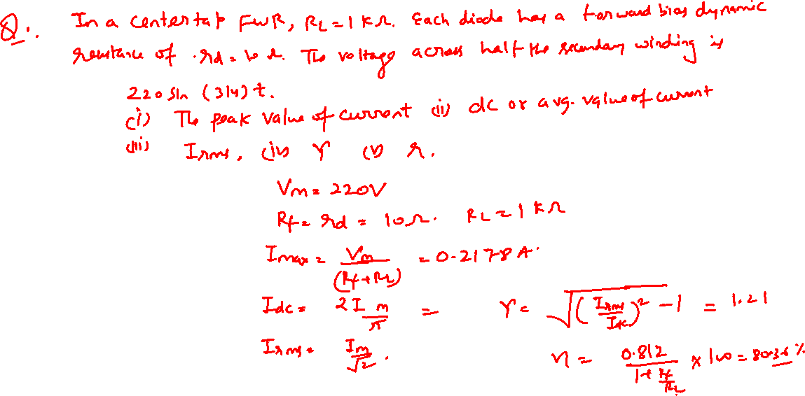
Filter Circuit

Slide 2
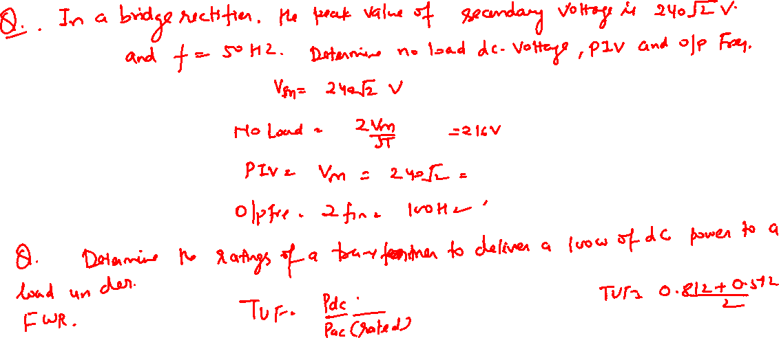
Filter Circuit

Slide 3
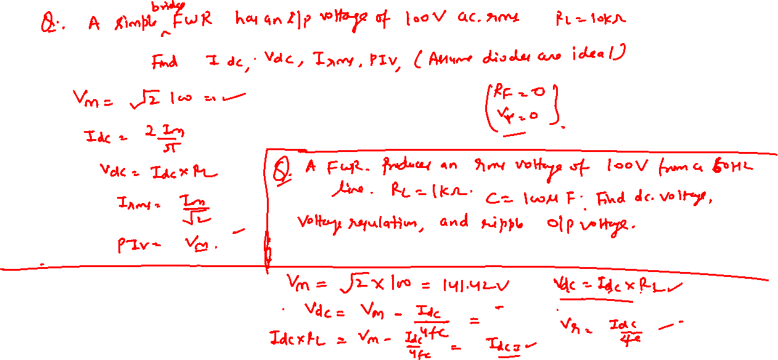
Filter Circuit

Slide 4


Diode as a Rectifier

